Slide 1
Lecture 12: System Models (continued)
UML: use cases, associated sequence diagrams
Automata: state machines, state charts
Synchronous languages
(NOTE: many slides here are from Marwedel material)

Slide 2
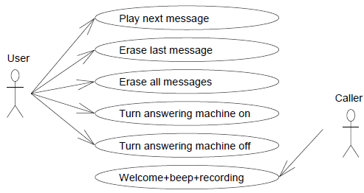
Use cases
Use cases describe possible applications of the SUD (System Under Development)
Included in UML (UnifiedModeling Language)
Neither a precisely specified model of the computations nor a precisely specified model of the communication
Example: Answering machine

Slide 3
[Message] Sequence charts (Sequence diagrams) [MSCs]
Explicitly indicate exchange of information
One dimension (usually vertical dimension) reflects time
The other reflects distribution in space
Included in UML

Slide 4
Example
Answering Machine in UML
Note time flow top to bottom
Note “active” regions in individual component timelines

Slide 5
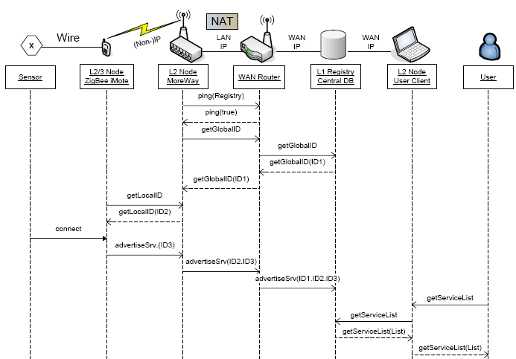
Example (2) (slightly different notation)
www.ist-more.org, deliverable 2.1

Slide 6

Application: In-Car Navigation System
Car radio with navigation system
User interface needs to be responsive
Traffic messages (TMC) must be processed in a timely way
Several applications may execute concurrently
© Thiele, ETHZ

Slide 7
System Overview (Components, Entity-Relationship Diagram) Note which components are inside system, which are outside
MMI
(MultiMedia Interface)
Communication
NAV
RADIO
DB
© Thiele, ETHZ

Slide 8
Use case 1: Change Audio Volume
< 200 ms
MMI
< 50 ms
Communication
NAV
RAD
DB
© Thiele, ETHZ

Slide 9
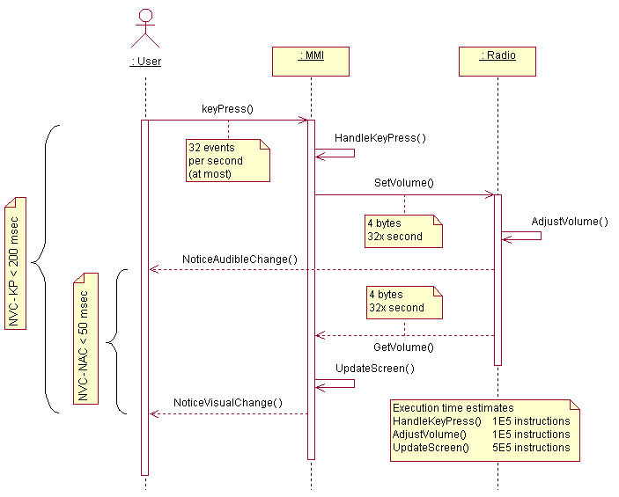



Use case 1: Change Audio Volume Note annotations showing time constraints and timing estimates
Communication
Resource
Demand
© Thiele, ETHZ

Slide 10
Use case 2: Lookup Destination Address
< 200 ms
MMI
Communication
NAV
RAD
DB
© Thiele, ETHZ

Slide 11
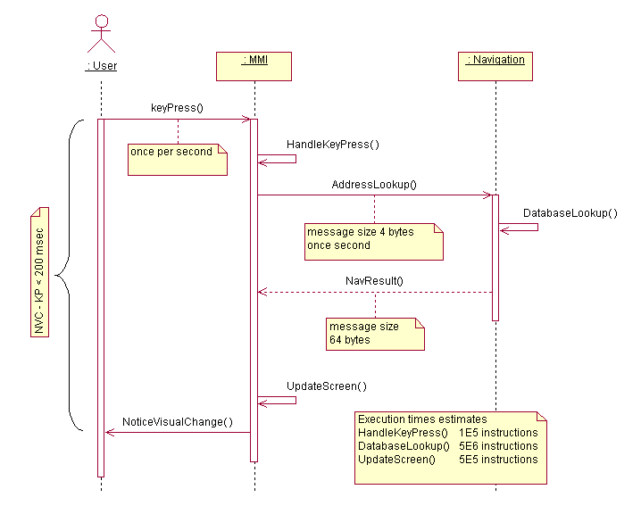
Use case 2: Lookup Destination Address
© Thiele, ETHZ

Slide 12
Use case 3: Receive Traffic Management Center (TMC) Messages
MMI
< 1000 ms
Communication
NAV
RAD
DB
© Thiele, ETHZ

Slide 13
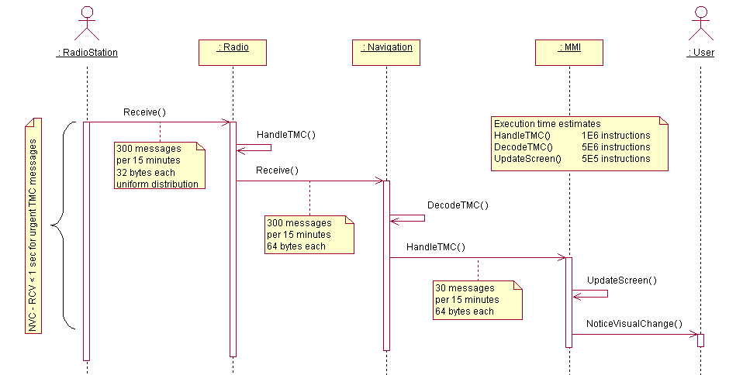
Use case 3: Receive TMC Messages
© Thiele, ETHZ

Slide 14
Life Sequence Charts* (LSCs)
Key problems observed with standard MSCs (Message Sequence Charts):
During the design process, MSC are initially interpreted as
“what could happen”
(existential interpretation, still allowing other behaviors).
Later, they are frequently assumed to describe
“what must happen”
(referring to what happens in the implementation).
* W. Damm, D. Harel: LSCs: Breathing Life into Message Sequence Charts, Formal Methods in System Design, 19, 45–80, 2001

Slide 15
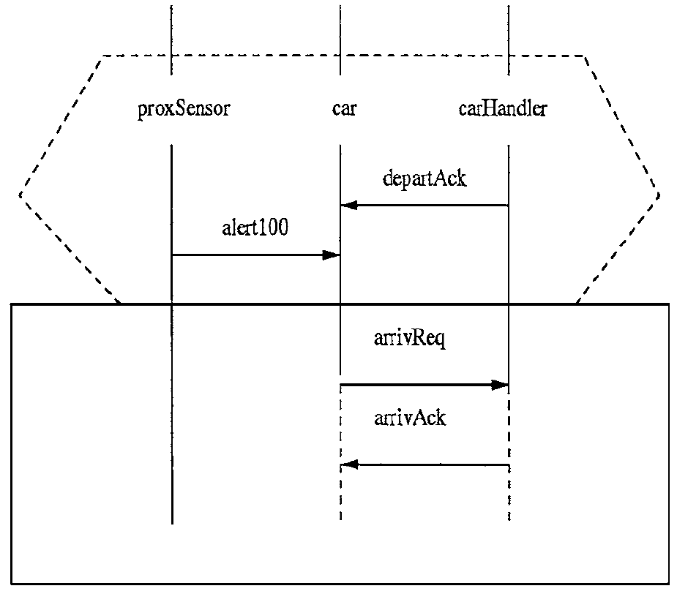
Extensions for LSCs (1)
Extension 1:
Introduction of pre-charts: Pre-charts describe conditions that must hold for the main chart to apply.
Example:
Pre-chart

Slide 16
Extensions (2)
Extension 2: Mandatory vs. provisional behavior
Level | Mandatory (solid lines) | Provisional (dashed lines)
Chart | All runs of the system satisfy the chart | At least one run of the system satisfies the chart
Location | Instance must move beyond location/time | Instance run need not move beyond loc/time
Message | If message is sent, it will be received | Receipt of message is not guaranteed
Condition | Condition must be met; otherwise abort | If condition is not met, exit subchart

Slide 17
(Message) Sequence Charts
PROs:
Appropriate for visualizing schedules,
Proven method for representing schedules in transportation.
Standard defined: ITU-TS Recommendation Z.120: Message Sequence Chart (MSC), ITU-TS, Geneva, 1996.
Semantics also defined: ITU-TS Recommendation Z.120: Message Sequence Chart (MSC)—Annex B: Algebraic Semantics of Message Sequence Charts, ITU-TS, Geneva.
CONS:
describes just one case, no timing tolerances: "What does an MSC specification mean: does it describe all behaviors of a system, or does it describe a set of sample behaviors of a system?” *
* H. Ben-Abdallah and S. Leue, “Timing constraints in message sequence chart specifications,” in Proc. 10th International Conference on Formal Description Techniques FORTE/PSTV’97, Chapman and Hall, 1997.

Slide 18
StateCharts: recap of classical automata
Classical automata:
input X
Internal state Z
output Y
clock
Moore- + Mealy automata=finite state machines (FSMs)
Next state Z⁺ computed by function δ Output computed by function λ
Z0
e=1
Z1
Moore-automata: Y = λ (Z); Z⁺ = δ (X, Z)
Mealy-automata Y = λ (X, Z); Z⁺ = δ (X, Z)
0
1
e=1
e=1
Z3
Z2
3
e=1
2

Slide 19
Timed automata
Timed automata = automata + models of time
The variables model the logical clocks in the system, that are initialized with zero when the system is started, and then increase synchronously with the same rate.
Clock constraints, i.e., guards on edges are used to restrict the behavior of the automaton. A transition represented by an edge is allowed to be taken when the clocks values satisfy the guard labeled on the edge.
Additional invariants make sure that the transition is taken.
Clocks may be reset to zero when a transition is taken [Bengtsson and Yi, 2004].
Ex: what may happen if x = 4.5? Must it happen?
what happens if x > 5?

Slide 20
Example: Answering machine
Ensures that transition takes place
May take place, but does not have to
NOTE: this says human must answer phone before x > 5;
but answering machine may engage if x gets to 4

Slide 21
StateCharts
Classical automata not useful for complex systems (complex graphs cannot be understood by humans).
☞ Introduction of hierarchy  StateCharts [Harel, 1987]
Used here as a (prominent) example of a model of computation based on shared memory communication.
appropriate only for local (non-distributed) systems

Slide 22
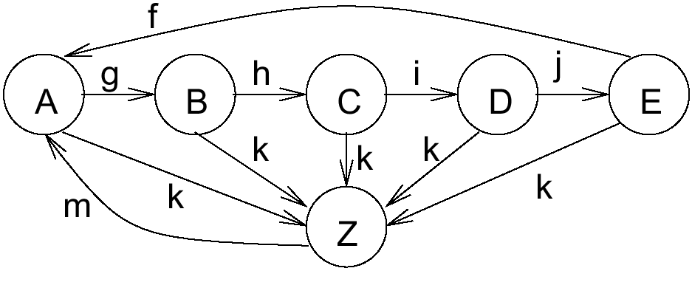
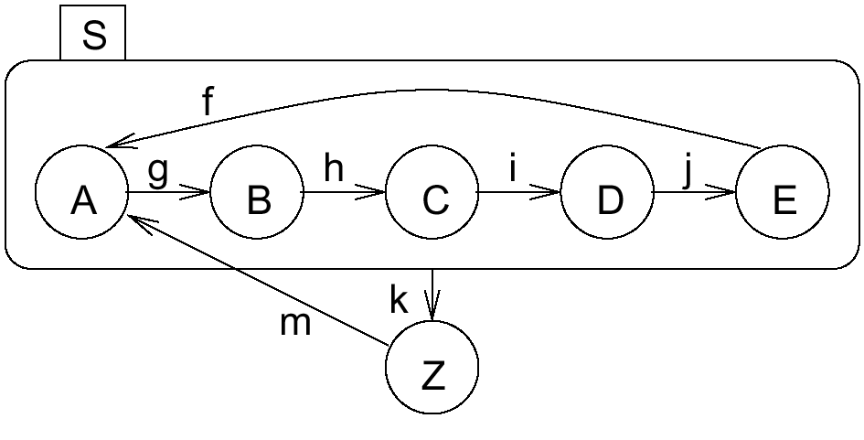
Introducing hierarchy
FSM will be in exactly one of the substates of S if S is active (either in A or in B or ..)

Slide 23
Broadcast mechanism
Values of variables are visible to all parts of the StateChart model
New values become effective in phase 3 of the current step and are obtained by all parts of the model in the following step.
!
☞ StateCharts implicitly assumes a broadcast mechanism for variables (→ implicit shared memory communication –other implementations would be very inefficient -).
☞ StateCharts is appropriate for local control systems, but not for distributed applications for which updating variables might take some time.

Slide 24
Lifetime of events
Events live until the step following the one in which they are generated (“one shot-events“).

Slide 25
Conflicts
1
2
What happens if system is in state 1 when A occurs?
What happens if x = 15?
Techniques for resolving these conflicts wanted

Slide 26
Determinate vs. deterministic
Kahn (1974) calls a system determinate if we will always obtain the same result for a fixed set (and timing) of inputs
Others call this property deterministic However, this term has several meanings:
Non-deterministic finite state machines
Non-deterministic operators (e.g. + with non-deterministic result in low order bits)
Behavior not known before run-time (unknown input results in non-determinism)
In the sense of determinate as used by Kahn
In order to avoid confusion, Marwedel uses the term “determinate“

Slide 27
Are StateCharts determinate (deterministic) or not?
Determinate (in this context) means:
All simulators return the same result for a given input?
Separation into 2 phases a required condition
Semantics: may be non-determinate
Potential other sources of non-determinate behavior:
Choice between conflicting transitions resolved arbitrarily
Tools typically issue a warning if such a situation could exist

Slide 28
Evaluation of StateCharts
Cons:
Not useful for distributed applications,
No program constructs,
No description of non-functional behavior,
No object-orientation,
No description of structural hierarchy.
Generated C programs may be inefficient.
Extensions:
Module charts for description of structural hierarchy.

Slide 29
Synchronous vs. asynchronous languages (1)
Description of several processes in many languages non-determinate: The order in which executable tasks are executed is not specified (may affect result).
Synchronous languages: based on automata models.
“Synchronous languages aim at providing high level, modular constructs, to make the design of such an automaton easier [Nicolas Halbwachs].
Synchronous languages describe concurrently operating automata. “.. when automata are composed in parallel, a transition of the product is made of the "simultaneous" transitions of all of them“.

Slide 30
Synchronous vs. asynchronous languages (2)
Synchronous languages implicitly assume the presence of a (global) clock. Each clock tick, all inputs are considered, new outputs and states are calculated and then the transitions are made.

Slide 31
Abstraction of delays
Let
f(x): some function computed from input x,
Δ(f(x)): the delay for this computation
δ: some abstraction of the real delay (e.g. a safe bound)
Consider compositionality: f(x)=g(h(x))
Then, the sum of the delays of g and h would be a safe upper bound on the delay of f.
Two solutions:
δ =0, always  synchrony
δ =? (hopefully bounded)  asynchrony
Asynchronous languages don’t work [Halbwachs] (Examples based on missing link to real time, e.g. what exactly does a wait(10 ns) in a programming language do?)
Based on slide 15 of N. Halbwachs: Synchronous Programming of Reactive Systems, ARTIST2 Summer School on Embedded Systems, Florianopolis, 2008

Slide 32
Compositionality
At the abstract level, a single FSM reacts immediately
At the abstract level, reaction of connected other automata is immediate
Based on slide 16 of N. Halbwachs: Synchronous Programming of Reactive Systems, ARTIST2 Summer School on Embedded Systems, Florianopolis, 2008

Slide 33
Concrete Behavior
The abstraction of synchronous languages is valid, as long as real delays are always shorter than the clock period.
Reference: slide 17 of N. Halbwachs: Synchronous Programming of Reactive Systems, ARTIST2 Summer School on Embedded Systems, Florianopolis, 2008

Slide 34
Synchronous languages
Require a broadcast mechanism for all parts of the model.
Idealistic view of concurrency.
Have the advantage of guaranteeing determinate behavior.

Slide 35
Implementation and specification model
For synchronous languages, the implementation model is that of finite state machines (FSMs).
The specification may use different notational styles
“Imperative”: Esterel (textual)
SyncCharts: graphical version of Esterel
“Data-flow”: Lustre (textual)
SCADE (graphical) is a mix containing elements from multiple styles
Nevertheless, specifications always include a close link to the generated FSMs

Slide 36
Summary
Early design phases
Text, Use cases, (M)SCs
Finate state machine-based models
Timed automata
StateCharts
AND-states, OR-states, Timer, Broadcast
Semantics: multi/single-phase models
Determinate, deterministic
Synchronous languages
Based on clocked finite state machine view
Based on 0-delay (real delays must be small)

